Slide 1
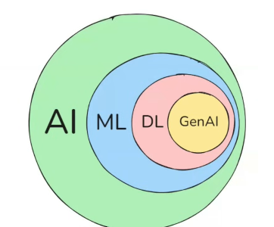

π
Chains
Langchain
Notes:
Content: https://www.linkedin.com/pulse/chunking-strategies-ai-data-kash-kashyap-0lghe/

Slide 2
Chaining means connecting different components to build complex LLM-powered applications.
Each component takes some input, processes it and passes the output to the next component.
This helps in building sophisticated and complex applications.
Chains help in building pipelines.
🔗‍
🔗‍
🔗‍
Notes:
Content: https://www.linkedin.com/pulse/chunking-strategies-ai-data-kash-kashyap-0lghe/

Slide 3
Why do we need Chains?
1. Simplify Data Flow
Chains handle how data moves between steps for you, so we don’t have to manually wire everything together. This makes our code cleaner, easier to understand, and less prone to errors.
2. Multi-step application logic
Real-world applications often require multiple LLM calls and various prompt templates to handle complex tasks. Manually managing this can get messy and error-prone, but chains simplify the process by organizing it into a clear, structured flow.
3. Scaling Becomes Easier
Chaining makes each component reusable, so we can easily switch between models or services without reworking your entire app. This flexibility is key when our project grows or needs to adapt quickly. For example — we can just switch between LLM models Gemini to OpenAI with a single line of code, without needing to make any modifications in other components.
Now we know why we need chains in the first place. So we can move towards the coding part wherein we will understand different types of chaining with their Python implementation.
Notes:
Content: https://www.linkedin.com/pulse/chunking-strategies-ai-data-kash-kashyap-0lghe/

Slide 4
Chains
Chains are a series of steps and action
Chains allow us to combine multiple component together to solve a specific task and build an entire LLM Application
from langchain_google_genai import ChatGoogleGenerativeAI
from langchain.prompts import PromptTemplate
from dotenv import load_dotenv, find_dotenv
load_dotenv(find_dotenv(), override=True)
llm = ChatGoogleGenerativeAI( model="gemini-2.5-flash", temperature=0.7 )
template = "Give me 5 creative names for {item}"
prompt_template = PromptTemplate( template=template, input_variables=["item"] )
prompt= chain.invoke({"item": "US startups"})
response= llm.invoke(prompt)
print( result.content )
Notes:
Content: https://www.linkedin.com/pulse/chunking-strategies-ai-data-kash-kashyap-0lghe/

Slide 5
from langchain_google_genai import ChatGoogleGenerativeAI
from langchain.prompts import PromptTemplate
from dotenv import load_dotenv, find_dotenv
load_dotenv(find_dotenv(), override=True)
llm = ChatGoogleGenerativeAI( model="gemini-2.5-flash", temperature=0.7 )
template = "Give me 5 creative names for {item}"
prompt_template = PromptTemplate( template=template, input_variables=["item"] )
chain = prompt_template | llm
#chain= RunnableSequence( prompt_template, llm)
result = chain.invoke({"item": "US startups"})
print( result.content )
Sequential Chain
In Sequential Chain,
we pass the output of the current component serves as an input to the next component.
Notes:
Content: https://www.linkedin.com/pulse/chunking-strategies-ai-data-kash-kashyap-0lghe/

Slide 6
Parallel Chain
Conditional Chain
Notes:
Content: https://www.linkedin.com/pulse/chunking-strategies-ai-data-kash-kashyap-0lghe/

Slide 7
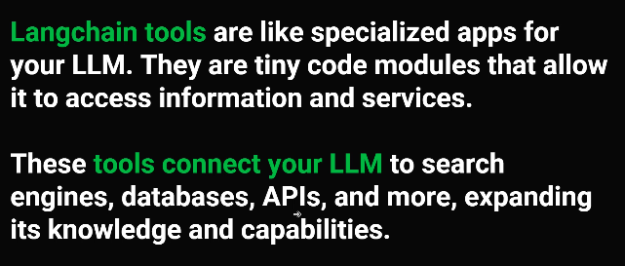
Notes:
Content: https://www.linkedin.com/pulse/chunking-strategies-ai-data-kash-kashyap-0lghe/

Slide 8
Notes:
Content: https://www.linkedin.com/pulse/chunking-strategies-ai-data-kash-kashyap-0lghe/

Slide 9
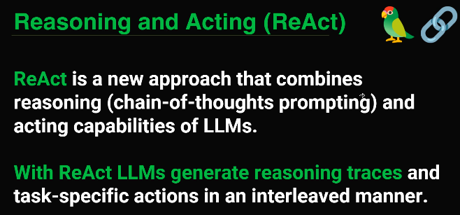
Notes:
Content: https://www.linkedin.com/pulse/chunking-strategies-ai-data-kash-kashyap-0lghe/

Slide 10
Notes:
Content: https://www.linkedin.com/pulse/chunking-strategies-ai-data-kash-kashyap-0lghe/

Slide 11
Notes:
Content: https://www.linkedin.com/pulse/chunking-strategies-ai-data-kash-kashyap-0lghe/

Slide 12
Notes:
Content: https://www.linkedin.com/pulse/chunking-strategies-ai-data-kash-kashyap-0lghe/

Slide 13
Notes:
Content: https://www.linkedin.com/pulse/chunking-strategies-ai-data-kash-kashyap-0lghe/

